Slide 1
Linear Regression, Decision Tree & EM Collaborative Filtering
Group 4

Slide 2
Decision Tree :Sample question
“An airplane manufacturer has three factories A B and C which produce 50%, 25%, and 25%, respectively, of a particular airplane. Seventy percent of the airplanes produced in factory A are passenger airplanes, 25% of those produced in factory B are passenger airplanes, and 25% of the airplanes produced in factory C are passenger airplanes. If an airplane produced by the manufacturer is selected at random, calculate the probability the airplane will be a passenger plane.”

Slide 3
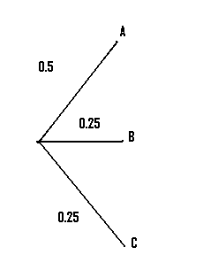
Steps:
Step 1: Draw lines to represent the first set of options in the question (in our case, 3 factories). Label them (our question list A B and C so that is what we’ll use here).
Step 2: Convert the percentages to decimals, and place those on the appropriate branch in the diagram. For our example, 50% = 0.5, and 25% = 0.25.

Slide 4
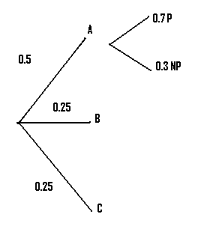
Steps (Contd..)
Step 3: Draw the next set of branches. In our case, we were told that 70% of factory A’s output was passenger. Converting to decimals, we have 0.7 P (“P” is just my own shorthand here for “Passenger”) and 0.3 NP (“NP” = “Not Passenger”).

Slide 5
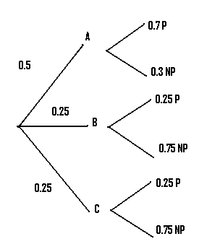
Step 4:Repeat step 3 for as many branches as you are given.

Slide 6
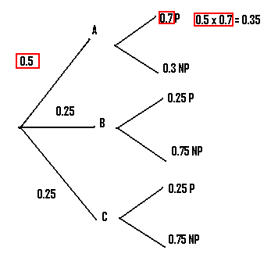
Step 5: Multiply the probabilities of the first branch that produces the desired result together. In our case, we want to know about the production of passenger places, so we choose the first branch that leads to P.

Slide 7
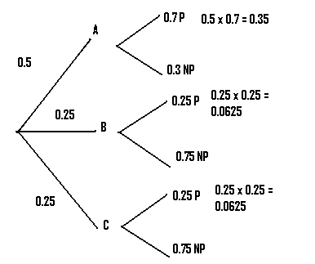
Step 6: Multiply the remaining branches that produce the desired result. In our example there are two more branches that can lead to P.

Slide 8
Step 6: Add up all of the probabilities you calculated in steps 5 and 6. In our example, we had:
➔ .35 + .0625 + .0625 = .475

Slide 9
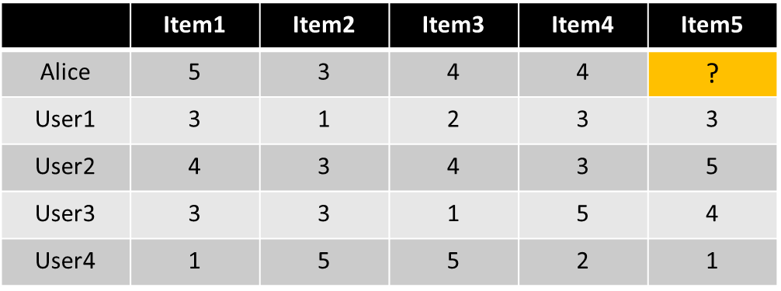
EM Collaborative filtering
User-based nearest-neighbor collaborative filtering
Example
A database of ratings of the current user, Alice, and some other users is given
Determine whether Alice will like or dislike Item5, which Alice has not yet rated or seen

Slide 10

Some first questions
How do we measure similarity?
How many neighbors should we consider?
How do we generate a prediction from the neighbors' ratings?

Slide 11
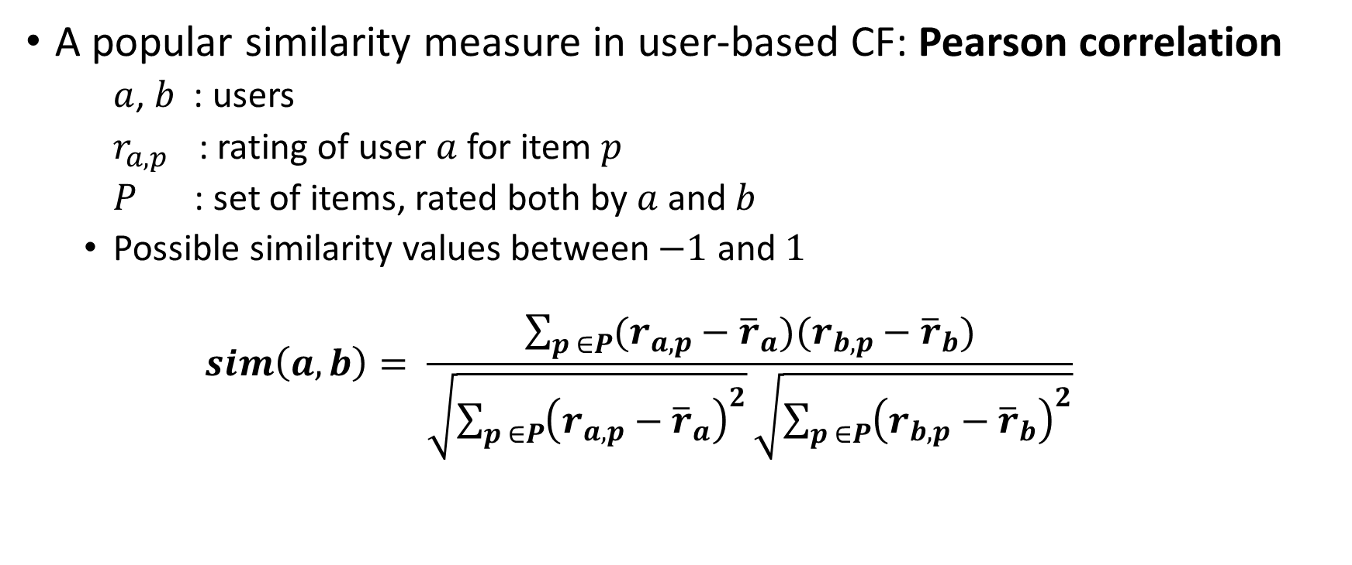
Measuring user similarity
A popular similarity measure in user-based CF: Pearson correlation
$a$, $b$ : users
$r_{a,p}$ : rating of user $a$ for item $p$
$P$ : set of items, rated both by $a$ and $b$
Possible similarity values between $−1$ and $1$
$$sim\left(a,b\right)= \frac{\sum_{p ∈P}{(r_{a,p}−{\overline{r}}_{a})(r_{b,p}−{\overline{r}}_{b})}}{\sqrt{\sum_{p ∈P}{{\left(r_{a,p}−{\overline{r}}_{a}\right)}^{2}}}\sqrt{\sum_{p ∈P}{{\left(r_{b,p}−{\overline{r}}_{b}\right)}^{2}}}}$$

Slide 12
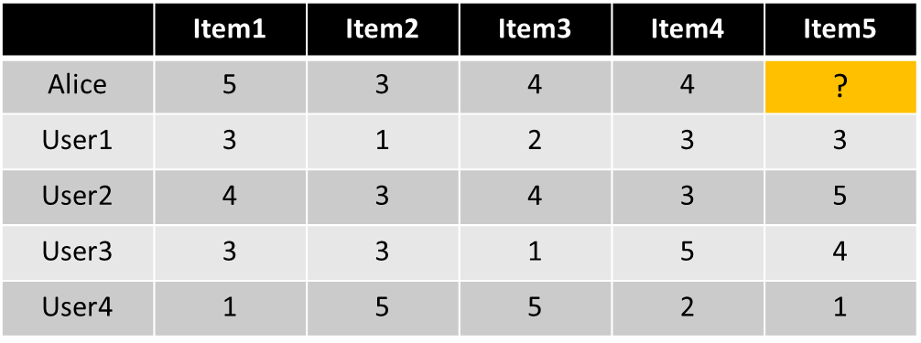
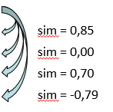

A popular similarity measure in user-based CF: Pearson correlation
$a$, $b$ : users
$r_{a,p}$ : rating of user $a$ for item $p$
$P$ : set of items, rated both by $a$ and $b$
Possible similarity values between $−1$ and $1$

Slide 13
Pearson correlation
Takes differences in rating behavior into account
Works well in usual domains, compared with alternative measures
such as cosine similarity

Slide 14
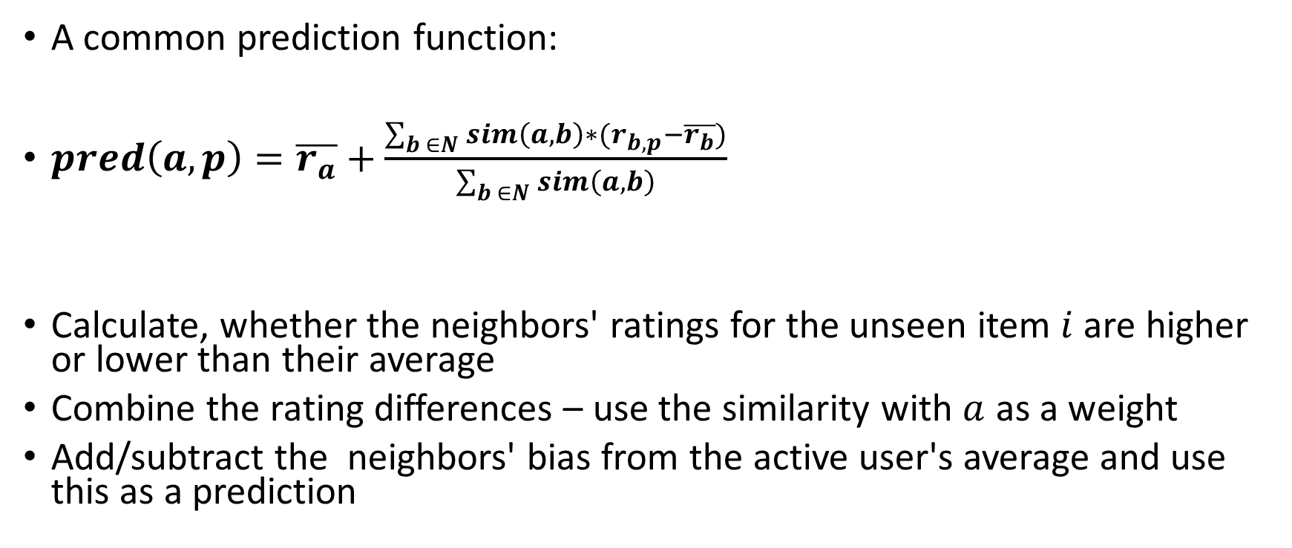
Making predictions
A common prediction function:
$pred\left(a,p\right)=\overline{r_{a}}+\frac{\sum_{b ∈N}{sim\left(a,b\right)∗(r_{b,p}−\overline{r_{b}})}}{\sum_{b ∈N}{sim\left(a,b\right)}}$
Calculate, whether the neighbors' ratings for the unseen item $i$ are higher or lower than their average
Combine the rating differences – use the similarity with $a$ as a weight
Add/subtract the neighbors' bias from the active user's average and use this as a prediction

Slide 15
Linear Regression
In correlation, the two variables are treated as equals.
In regression, one variable is considered independent (=predictor) variable (X) and the other the dependent (=outcome) variable Y.

Slide 16
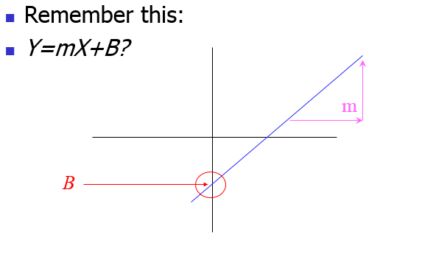
What is “Linear”?

Slide 17
Regression Equation
Expected value of y at a given level of x=

Slide 18
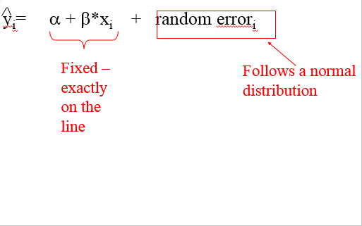
Predicted value for an individual…

Slide 19
Assumptions
Linear regression assumes that…
1. The relationship between X and Y is linear
2. Y is distributed normally at each value of X
3. The variance of Y at every value of X is the same (homogeneity of variances)
4. The observations are independent

Slide 20
Example: Computer Repair
A company markets and repairs small computers. How fast (Time) an electronic component (Computer Unit) can be repaired is very important to the efficiency of the company. The Variables in this example are:
Time and Units.
How long will it take me to repair this unit?
Goal: to predict the length of repair Time for a given number of computer Units

Slide 21
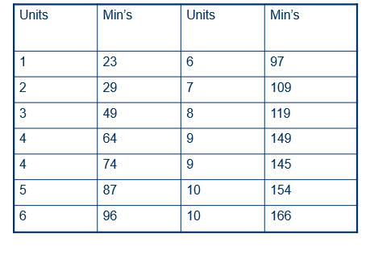
Repair data

Slide 22
Graphical Summary of Two Quantitative Variable
Scatterplot of response variable against explanatory variable
What is the overall (average) pattern?
What is the direction of the pattern?
How much do data points vary from the overall (average) pattern?
Any potential outliers?

Slide 23
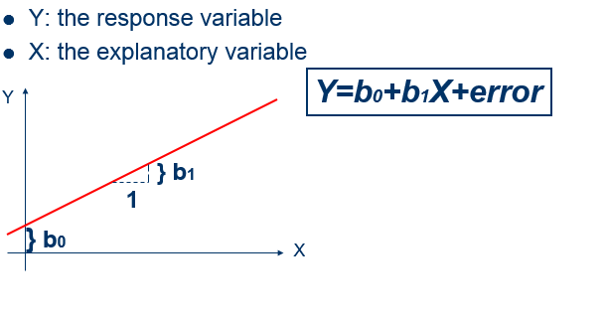
Linear Regression Model
The regression line models the relationship between X and Y on average.

Slide 24
Prediction
: Predicted value of Y for a given X value
Regression equation:
Eg. How long will it take to repair 3 computer units?

Slide 25
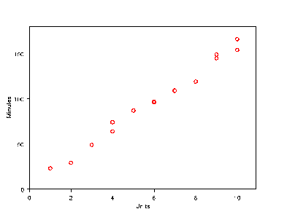

Slide 26
Correlation between X and Y
X and Y might be related to each other in many ways: linear or curved.

Slide 27
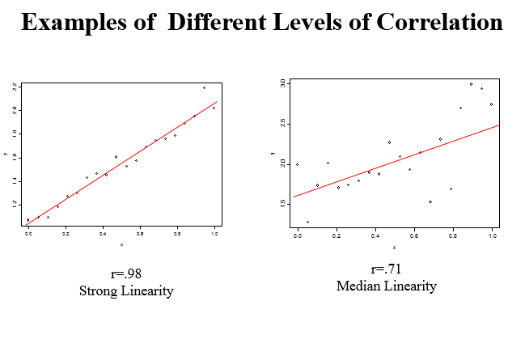

Slide 28
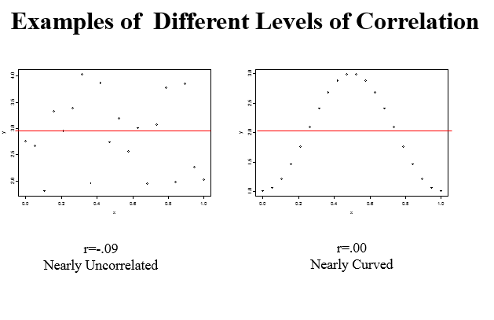

Slide 29
Computer repair time

Slide 30
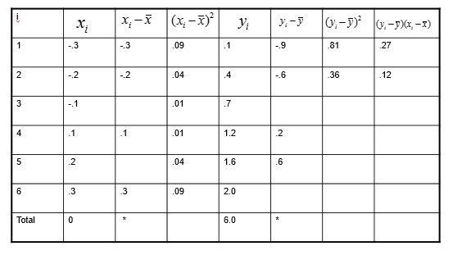
(1) Fill the following table, then compute the mean and st. deviation of Y and X
(2) Compute the corr. coef. of Y and X
(3) Draw a scatterplot

